Slide 1

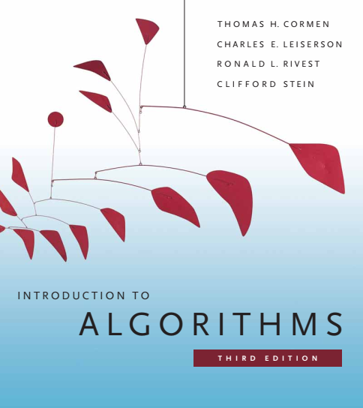
Design and Analysis of Algorithms
Dr. Sajid Iqbal
Reference Book
Introduction to Algorithms 3rd Edition By Thomas H. Cormen et. al.
https://mitpress.mit.edu/books/introduction-algorithms-third-edition
COMEDXD

Slide 2
Brute Force Method
A rough method to solve problem

Slide 3
Method Introduction
A programming style that does not include any shortcuts to improve performance
It relies on absolute computing power to try all possibilities until the solution is found
Brute-force search is simple but will always finds a solution if exists.
Its cost is proportional to the number of candidate solutions – which in many practical problems tends to grow very quickly as the size of the problem increases
Brute-force search is typically used when the problem size is limited and small
When there are problem-specific heuristics that can be used to reduce the set of candidate solutions to a manageable size
The method is also used when the simplicity of implementation is more important than speed
Brute-force search is also useful as a baseline method when benchmarking other algorithms or metaheuristics
It is also known as linear search

Slide 4
Example – Traveling Salesman Problem (TSP)
Let a salesman needs to visit 10 cities across the country
How to determine the order in which cities should be visited such that the total distance traveled is minimized?
The brute force solution is simply to calculate the total distance for every possible route and then select the shortest one.
This is not particularly efficient because it is possible to eliminate many possible routes through clever algorithms.

Slide 5
Brute Force Algorithm
Four procedures are required
first (P): generate a first candidate solution for P.
next (P, c): generate the next candidate for P after the current one c.
valid (P, c): check whether candidate c is a solution for P.
output (P, c): use the solution c of P as appropriate to the application.
c ← first(P)
while c ≠ Λ do
if valid(P,c) then
output(P, c)
c ← next(P, c)
end while

Slide 6


Example – Linear Search
Linear Search method is given two parameters
An array of numbers(sorted or unsorted): $Arr$
An element to search : $x$
 | Algorithm | Time Complexity | Space Complexity
S# | Instruction | Cost | Cost
1 | def Linear_Search(Arr,x): | T(n) | n+1
2 | for i in range(len(Arr)): | n+1 | I
3 | if Arr[i]== x: | n | 0
4 | return i | 1 | 0
5 | return -1 | 1 | 0
 |  | $$T(n)=O(n)$$ | $$S(n)=θ(n)$$
def Linear_Search(Arr,x): for i in range(len(Arr)): if Arr[i]== x: return i return -1 Arr=[0,1,2,3,4,5,6,7,8,9] loc=Linear_Search(Arr,8)

Slide 7

Example – Password Search
Let you have set password for your email account consisting of 4 digits (WXYZ) and you forgot it.
How to find it again.
Brute force method is to try out all possible combinations
WXYZ: Each of digit may have 1 value from possible 10 values (0-9)
Total combinations are $10.10.10.10 →{10}^{4} →10,000$
If you deploy a computer to find the solution and let suppose for worst case all combinations are tries.
Let time for checking 1 combination is 1ms. Total time will be ${10}^{4}∗{10}^{−3}=10s$
And for 10 digit password the time will be ${10}^{10}∗{10}^{−3}={10}^{7}→\frac{{10}^{7}}{3600}→\frac{2777}{24}=115 days$
A better method is required!

Slide 8
Example – Stock Trading
Let you are interested in trading shares of a company
You can buy one unit of stock only one time and then sell it at a later date and can learn what the price of the stock will be in the future.
The goal is to maximize your profit by using “buy low and sell high” principle
Within a given period, you might not be able to buy at the lowest price and then sell at the highest price

Slide 9
Share Price Details
we can maximize profit by buying at the lowest price, after day 7.
We will find the lowest price point (LPP) and highest price point (HPP)
The pair (LPP, HPP) will give us maximum profit
Counter Example shows that day (2,3) gives maximum profit however
Price on day is neither lowest nor price at day 3 is highest
Day | 0 | 1 | 2 | 3 | 4
Price | 10 | 11 | 7 | 10 | 6
Change |  | 13 | -3 | -25 | 20
Day | 0 | 1 | 2 | 3 | 4 | 5 | 6 | 7 | 8 | 9 | 10 | 11 | 12 | 13 | 14 | 15 | 16
Price | 100 | 113 | 110 | 85 | 105 | 102 | 86 | 63 | 81 | 101 | 94 | 106 | 101 | 79 | 94 | 90 | 97
Change |  | 13 | -3 | -25 | 20 | -3 | -16 | -23 | 18 | 20 | -7 | 12 | -5 | -22 | 15 | -4 | 7

Slide 10

A brute-force solution
Try every possible pair of buy and sell dates in which the buy date precedes the sell date
A period of n-days has $\left(\begin{matrix}n \\ 2\end{matrix}\right)=\frac{n!}{\left(2!\right)\left(n−2\right)!}$ pairs. It has time complexity $θ(n^{2})$
$\left(\begin{matrix}5 \\ 2\end{matrix}\right)=\frac{5!}{\left(2!\right)\left(5−2\right)!}=\frac{5!}{2!∗3!}=\frac{5∗4}{2}=10 →\{\left(1,2\right),\left(1,3\right),\left(1,4\right),\left(1,5\right),\left(2,3\right),\left(2,4\right),\left(2,5\right),\left(3,4\right),\left(3,5\right),(4,5)$
we can hope to evaluate each pair of dates in constant time,
this approach would take $Ω(n^{2})$ time

Slide 11

Thanks for watching
Dr. Sajid Iqbal
Assistant Professor
Department of Computer Science
Bahauddin Zakariya University, Multan
sajidiqbal.pk@gmail.com
YouTube Channel: COMEDXD
Allah Hafiz

